Slide 1
NoSQL DataBase

Slide 2
What is NoSQL?
NoSQL databases (aka "not only SQL") are non tabular, and store data differently than relational tables. NoSQL databases come in a variety of types based on their data model. The main types are document, key-value, wide-column, and graph. They provide flexible schemas and scale easily with large amounts of data and high user loads.

Slide 3
NoSQL characteristics:
NoSQL is a set of concepts that allows the rapid and efficient processing of data sets with a focus on performance, reliability, and agility.
The main characteristics:
It’s more than rows in tables—NoSQL systems store and retrieve data from many formats: key-value stores, graph databases, column-family (Bigtable) stores, document stores, and even rows in tables.
It’s free of joins—NoSQL systems allow you to extract your data using simple interfaces without joins.
It’s schema-free—NoSQL systems allow you to drag-and-drop your data into a folder and then query it without creating an entity-relational model.

Slide 4
It works on many processors—NoSQL systems allow you to store your database on multiple processors and maintain high-speed performance.
It uses shared-nothing commodity computers—Most (but not all) NoSQL systems leverage low-cost commodity processors that have separate RAM and disk.
It supports linear scalability—When you add more processors, you get a consistent increase in performance.
It’s innovative—NoSQL offers options to a single way of storing, retrieving, and manipulating data. NoSQL supporters (also known as NoSQLers) have an inclusive.
attitude about NoSQL and recognize SQL solutions as viable options. To the NoSQL community, NoSQL means “Not only SQL.”

Slide 5
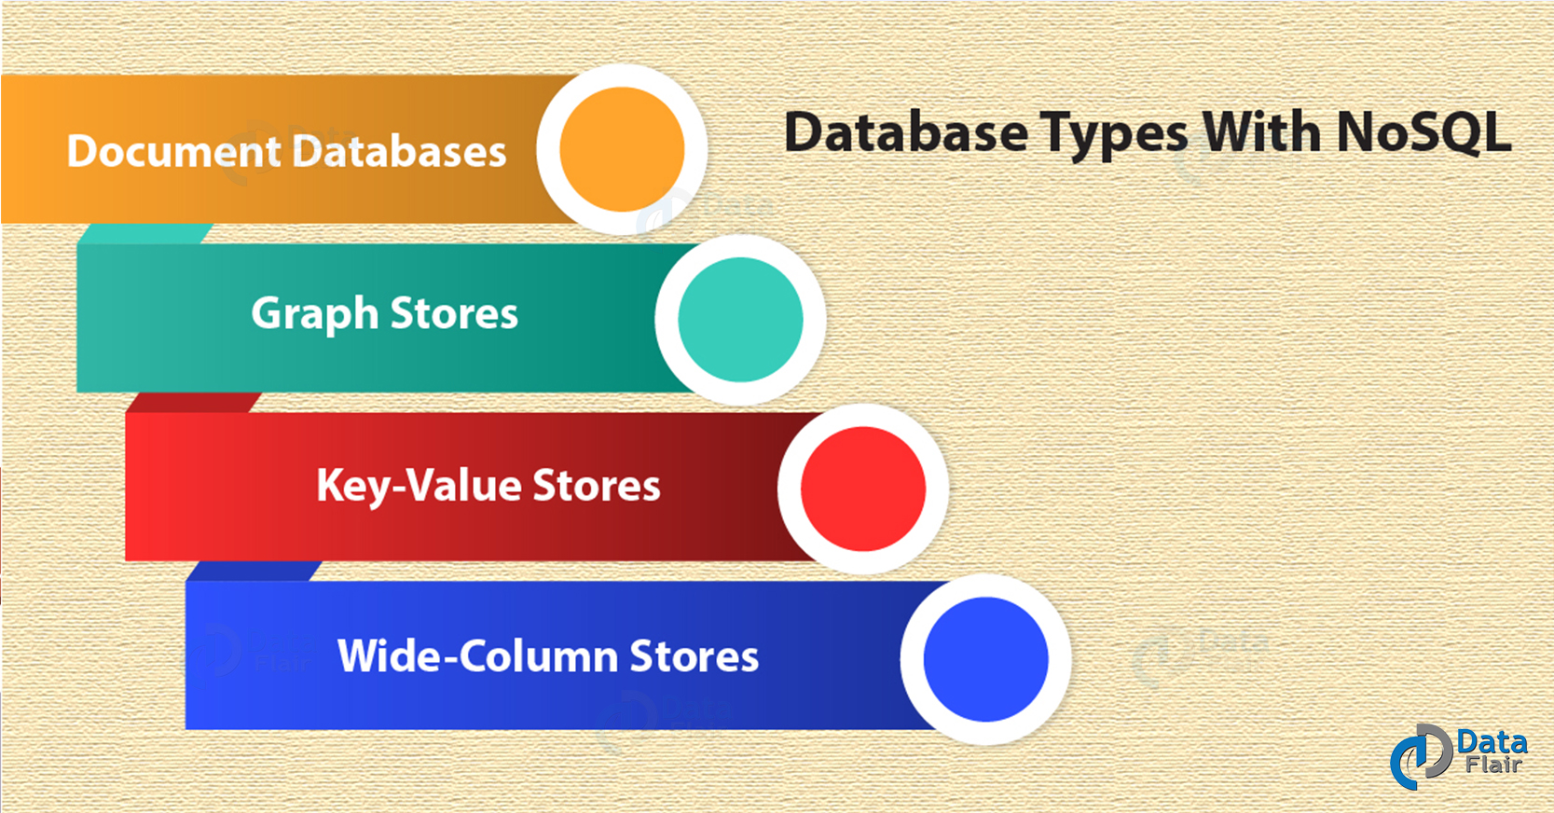
NoSQL databases types

Slide 6
The four main types of NoSQL databases are:
Document Databases:
A document database stores data in JSON,BSON , or XML documents (not Word documents or Google docs, of course). In a document database, documents can be nested. Particular elements can be indexed for faster querying.
(Example: MongoDB)
Key-value store:
The simplest type of NoSQL database is a key-value store . Every data element in the database is stored as a key value pair consisting of an attribute name (or "key") and a value. In a sense, a key-value store is like a relational database with only two columns: the key or attribute name (such as state) and the value (such as Alaska).
Use cases include shopping carts, user preferences, and user profiles.

Slide 7
Column-oriented databases:
While a relational database stores data in rows and reads data row by row, a column store is organized as a set of columns. This means that when you want to run analytics on a small number of columns, you can read those columns directly without consuming memory with the unwanted data.
Columnar databases can quickly aggregate the value of a given column (adding up the total sales for the year, for example). Use cases include analytics.
Graph databases:
A graph database focuses on the relationship between data elements. Each element is stored as a node. The connections between elements are called links or relationships. In a graph database, connections are first-class elements of the database, stored directly. In relational databases, links are implied, using data to express the relationships.

Slide 8
ACID Theorem
ACID Transactions are a very important feature that most relational databases have had for decades. They enable you to combine a series of different database operations into one transaction that provides the following four guarantees: Atomicity - that the operations will all either succeed or fail as a single unit; Consistency - that they won’t violate certain constraints you defined for the data as a whole; Isolation - that each operation is hidden from view until the whole transaction is complete; and Durability - that all changes to the data are safely persisted.

Slide 9
CAP Theorem:
The CAP theorem is a tool used to makes system designers aware of the trade-offs while designing networked shared-data systems. CAP has influenced the design of many distributed data systems. It made designers aware of a wide range of tradeoffs to consider while designing distributed data systems.

Slide 10
NoSQL advantages
Handle Large Volumes of Data at High Speed with a Scale-Out Architecture
Store Unstructured, Semi-Structured, or Structured Data
Enable Easy Updates to Schema and Fields
Take Full Advantage of the Cloud to Deliver Zero Downtime
Ability to handle change over time
Support for multiple data structures
Executing code next to the data

